Slide 1
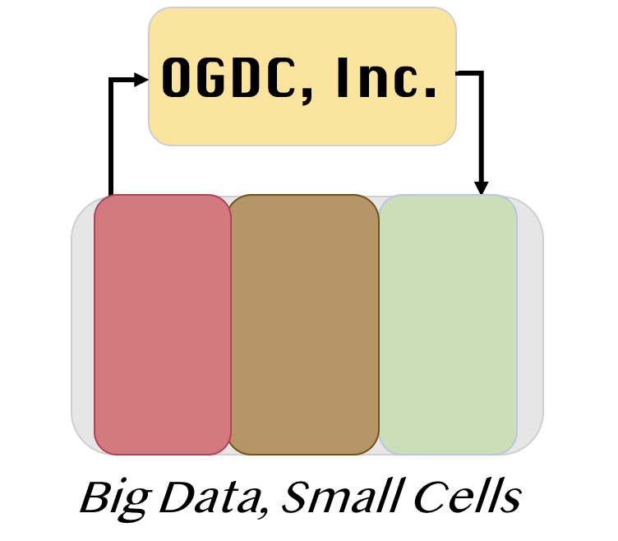
Off-Grid Data Center
Group B3
Chen Cai, Sesha Machiraju, Caitlin Weiss, Heejun You

Slide 2
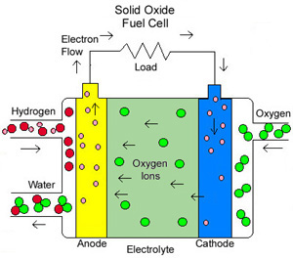
Background
Data Centers:
Advent of cloud services computing
More data requirements/storage → more energy
SOFCs:
Chemical reactions based at internal electrodes → electricity [1]
Input fuel sources include natural gas and air to produce mainly CO₂ and water along with electricity [2].
H₂+O²⁻→ H₂O + 2e⁻
CO+ O²⁻ → CO₂+2e⁻
0.5O₂+2e⁻ → O²⁻

Slide 3
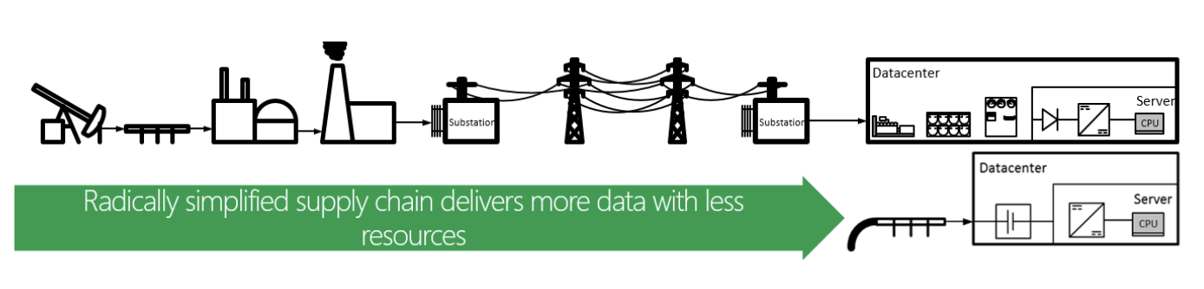
Motivation [3]
Energy source reliability
Acceptable efficiency levels
Lower GHG emissions
Lower Operation Costs
Ease of Reproducibility
Parallel Utilization
Parameters of Implementation:
10% profit in 10 years
Emissions are less than that of on-grid sources
Outages are significantly less than on-grid.

Slide 4
Technical Specifications
Main Assumptions
Rack Type: APC 42U Universal Rack (78.39” x 23.62” x 42.13”) [4]
Location: Data center is located outside of Salt Lake City, Utah, and because of the climate, swamp cooling is used [5]
Layout: Hot and cold aisle design for system cooling [6]
SOFC Life Cycle: 10 years [7]
Peak Rack Power: 16.67 kW [8]
Power Rating: 50 kW per SOFC
Number of Racks: 9000
Number of SOFCs: 1 SOFC/3 racks; 3000 SOFCs
Total Plant Power Requirement: 150 MW

Slide 5
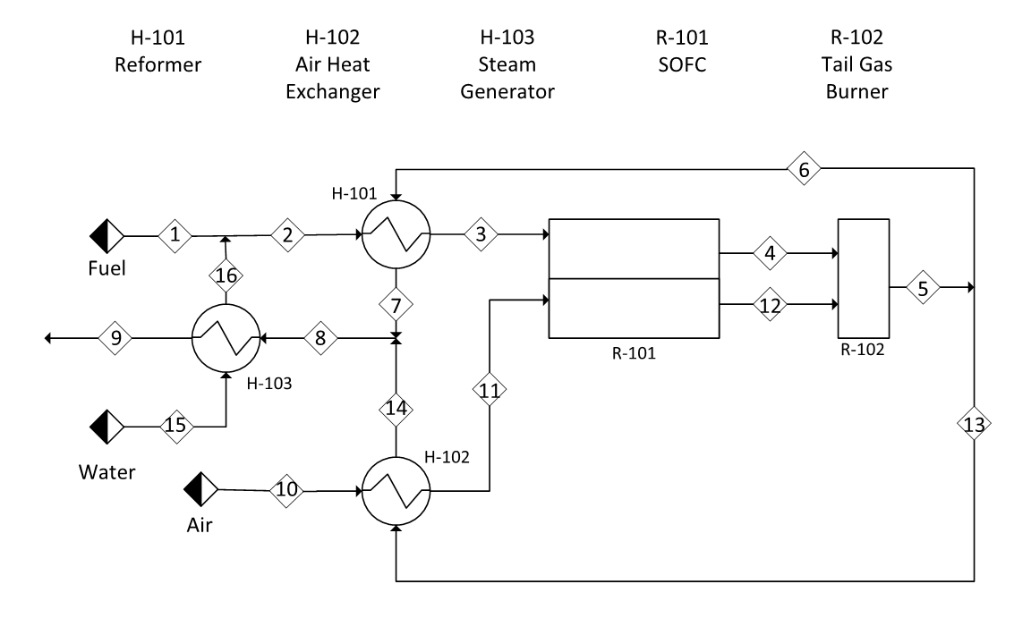
Optimized Flow Sheet & Stream Table

Slide 6
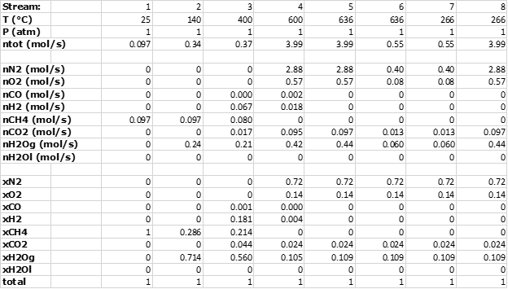

Slide 7
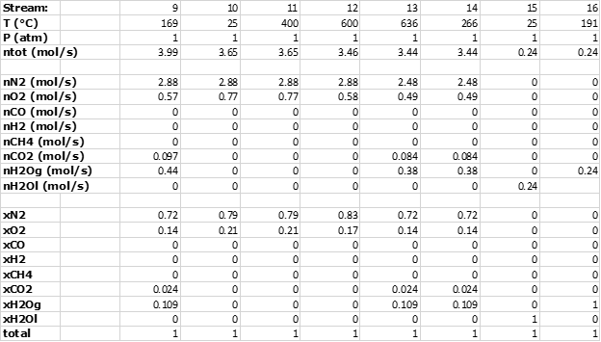

Slide 8
Unit Design Specifications
H-101
Fuel: 140°C upto 400°C
Exhaust: 636°C to 266°C
Heat transfer Area: 1.3m^2
Dimensions:
52.8*24.6*3.9 cm
H-102
Air: 25°C upto 400°C
Exhaust: 636°C to 266°C
Heat transfer Area: 5.8m^2
Dimensions:
52.8*24.6*13.7 cm
H-103
Water: 25°C upto 191°C
Exhaust: 266°C to 168°C
Heat transfer Area: 3.8m^2
Dimensions:
52.8*24.6*9.5 cm
11
6
13

Slide 9
Unit Design Specifications
R-102
Operating Temp:
600°C upto 636°C
Dimensions: N/A
Assumptions:
Spontaneous reaction
T-joint pipe
Etc.
Steam injector
Fuel: 25°C
Steam: 191°C
Mixture: 140°C
Assumptions:
Stream 2 is at 140°C
Etc.
Exhaust combiner
Key component in deciding the exhaust stream split ratio

Slide 10
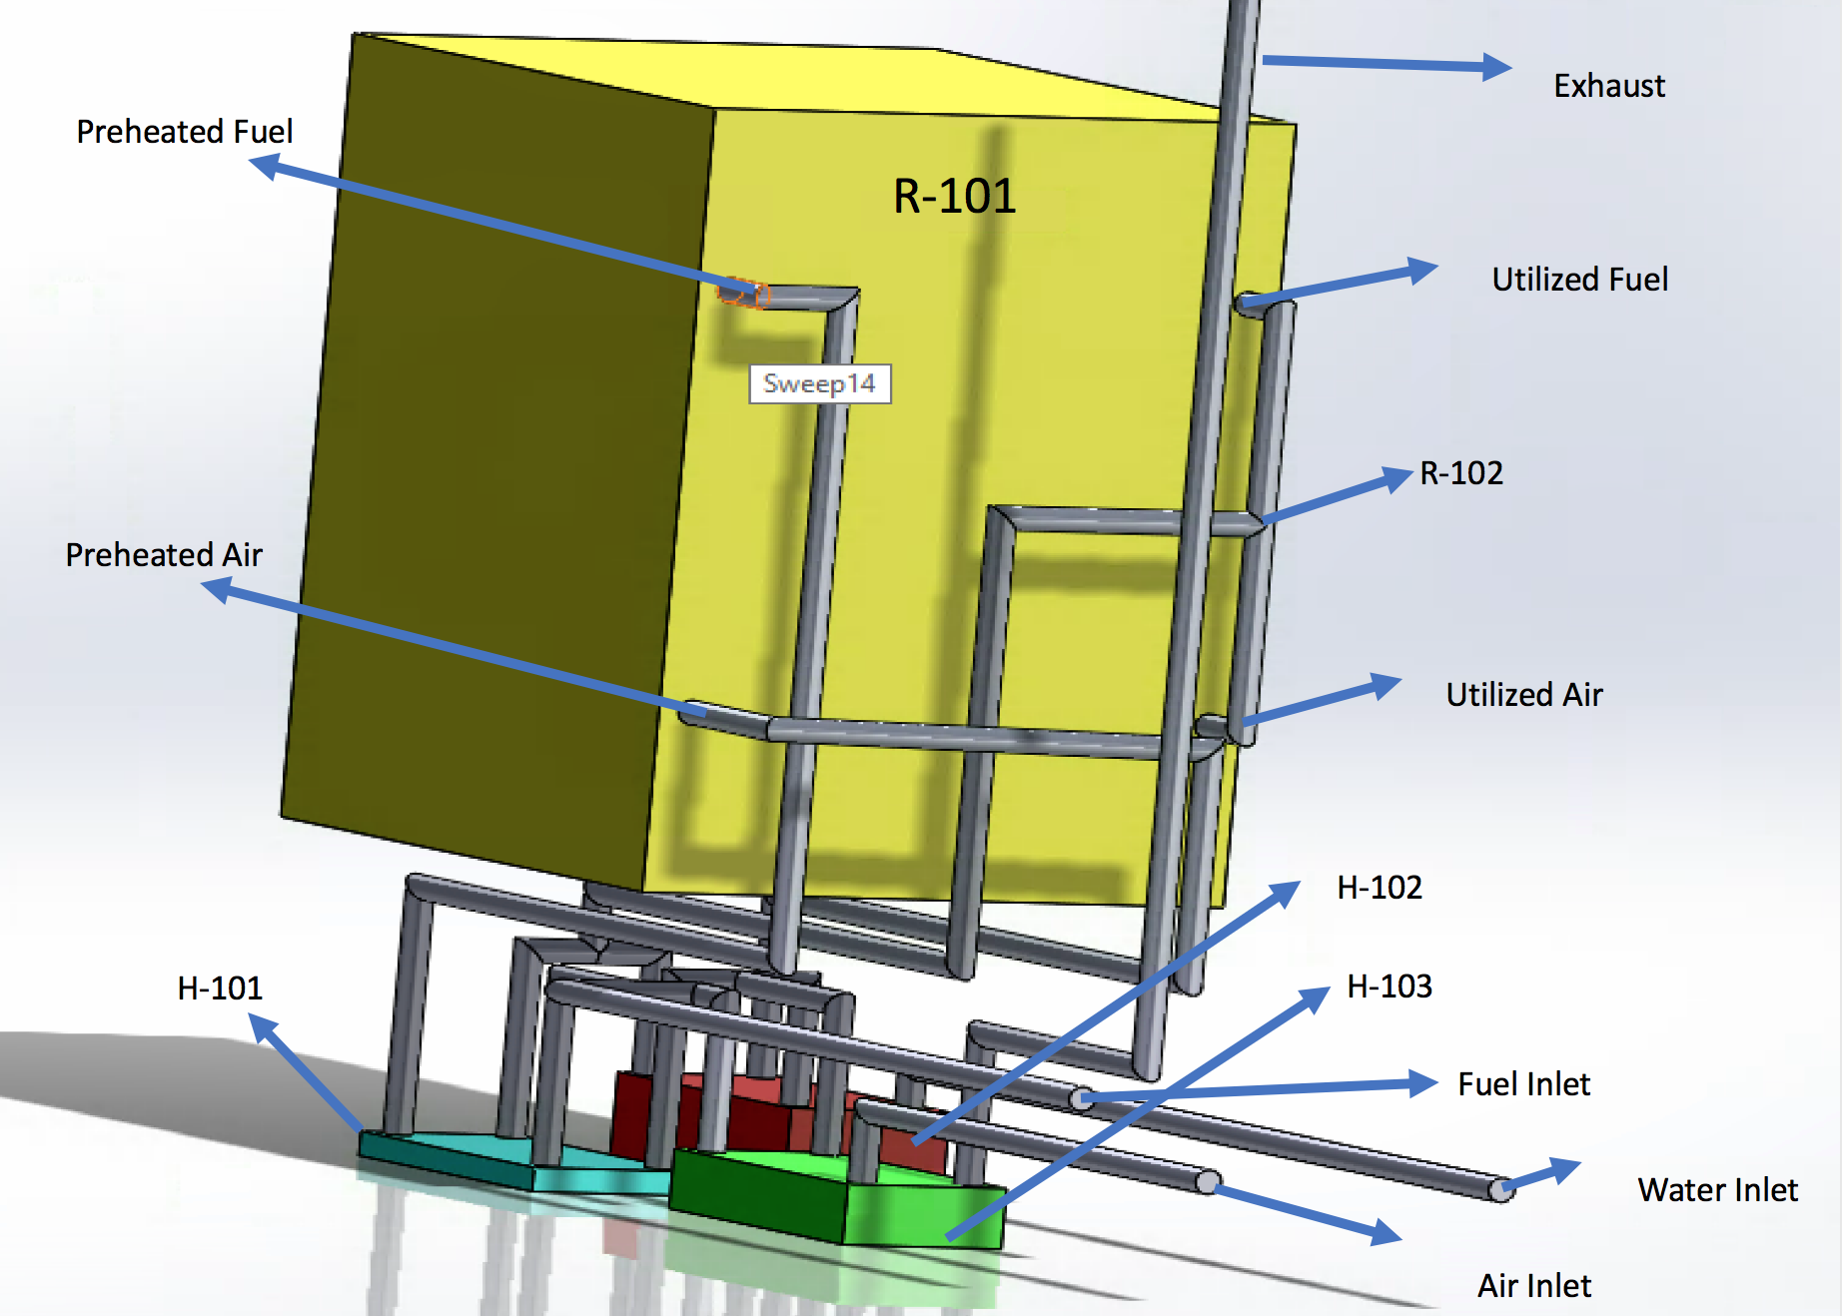
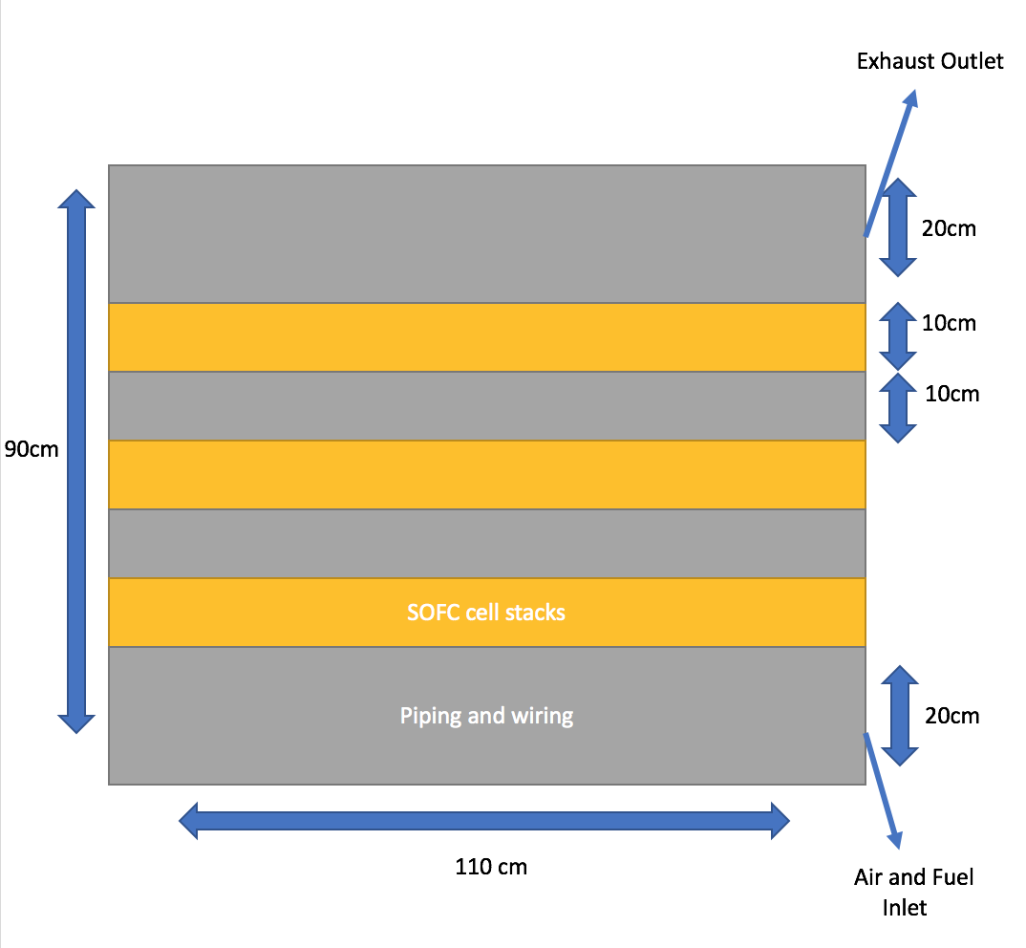
SOFC Hotbox & Cell Stacks Layout
100 cm x 150 cm x 200 cm
90 cm x 110 cm x 130 cm

Slide 11
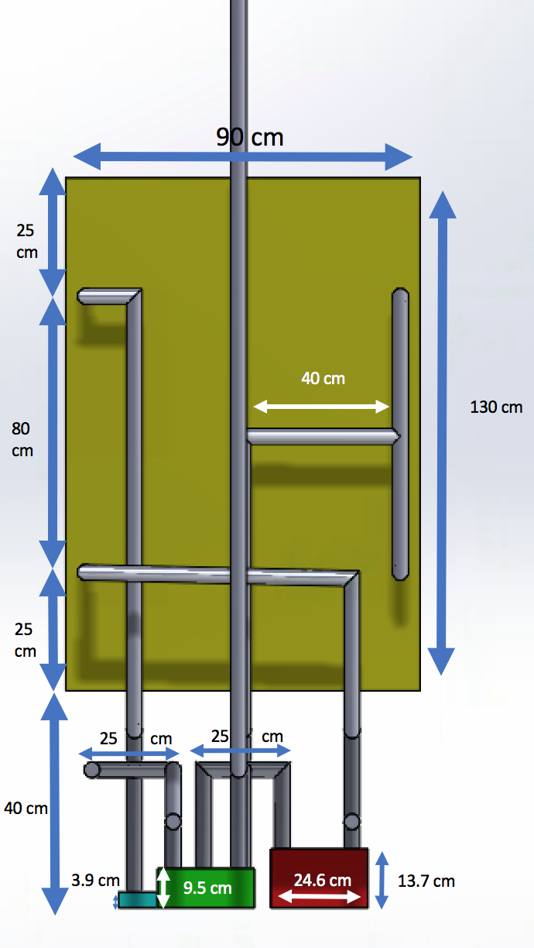
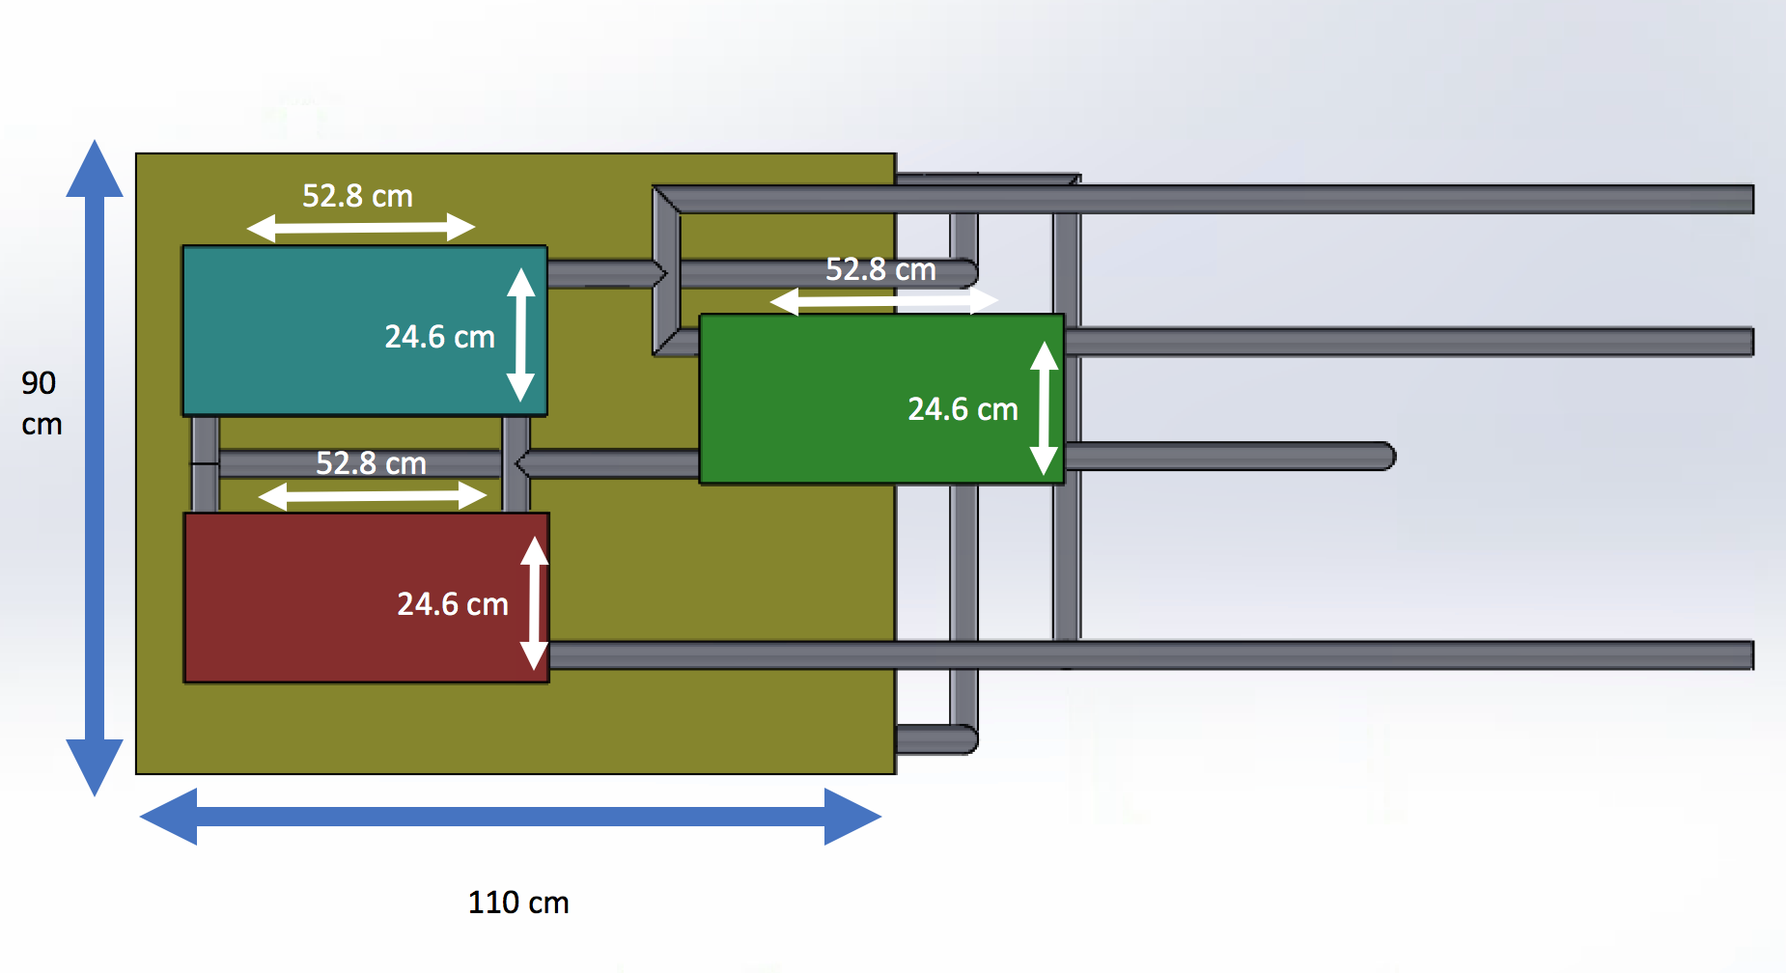
3 Views of the SOFC Hotbox Layout

Slide 12
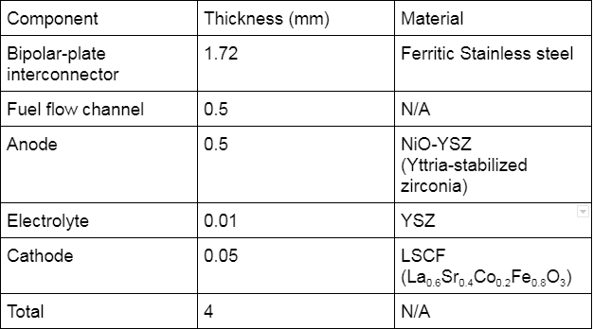
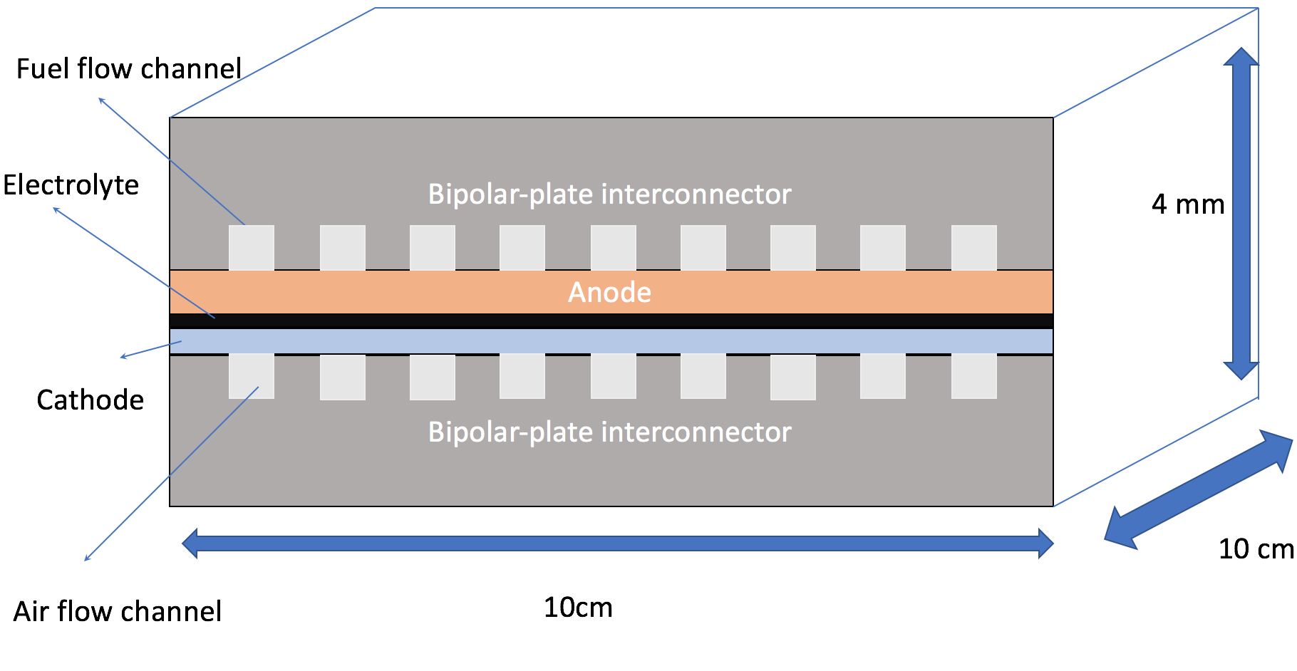
Fuel Cell Structure & Materials
[10, 11, 12]

Slide 13
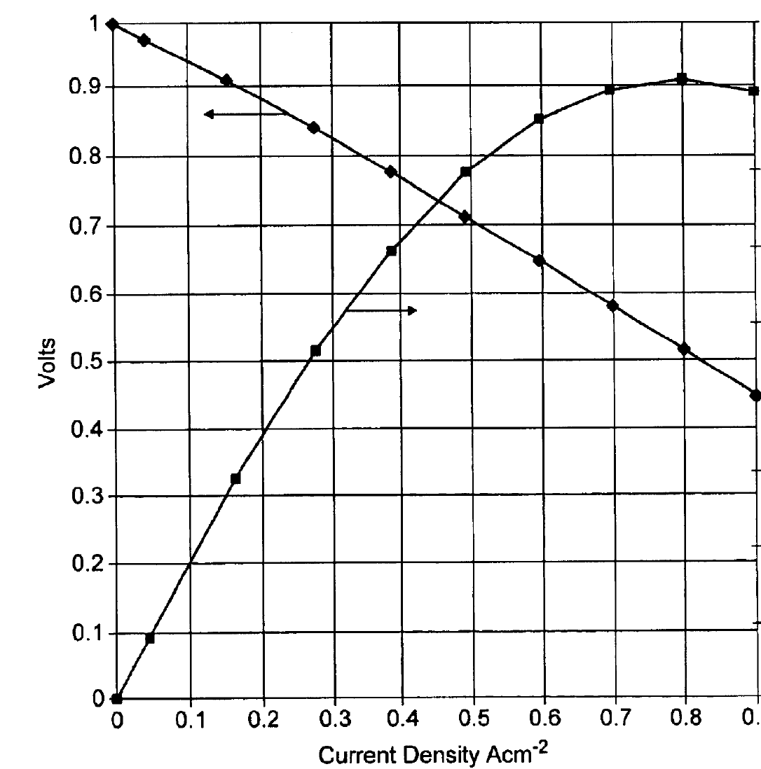
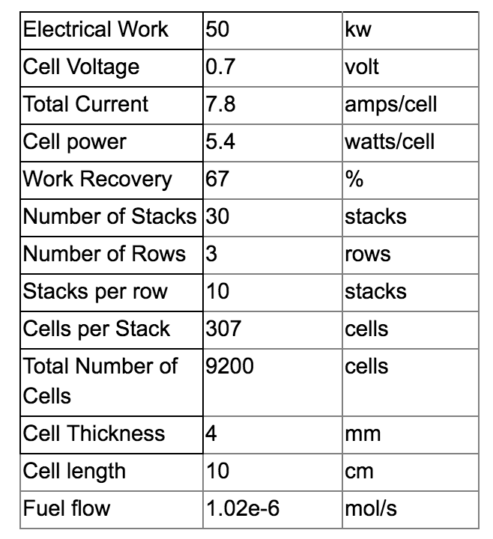
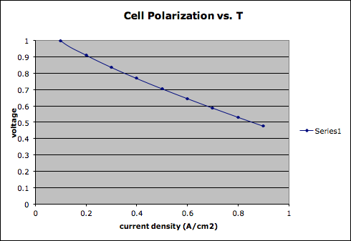
SOFC Specifications
[12]

Slide 14
SOFC Economics
SOFC price was back-calculated during our economic analysis, resulting in:
Each SOFC must cost $179000 or less to make 10% profit at the end of 10 years
Price per area of cell: 19.4 cents/cm²

Slide 15
Economic Analysis
Equipment/Input | On-Grid | Off-Grid
Electricity | $923,100,000. | N/A
UPS | $1,320,000. | N/A
Generators | $26,524,000. | N/A
LNG Storage Tanks | N/A | $270,000.
H-101 | N/A | $861,000.
H-102 | N/A | $5,019,000.
H-103 | N/A | $2,810,000.
R-101 | N/A | $537,188,600.
Hot Box Insulation | N/A | $1155000.
NG Feedstock | N/A | $308,396,000.
NG Piping | N/A | $150,000.
Total Cost | $950,000,000. | $850,000,000.

Slide 16
Specific Costs [10]
Equipment/Input | On-Grid Parameter | Off-Grid Parameter
Wholesale Electricity | $0.0787/kWh in UT | N/A
UPS | Eaton 93PM 50 kW UPS; 2N = 6 units | N/A
Backup Generators | 2 MW Cummins Diesel Generator (76 units) | N/A
Wholesale NG | N/A | $6.33/MCF in UT
LNG Storage Tanks | N/A | 1 unit = 1500 gal.; $1500/tonne
HX | Industry Model | HT Area (m²) | Price
H-101 | B3-36A 40 Plate Heat Exchanger with M8-1.25 Mounting Studs | 1.37 m² | $205/unit
H-102 | B3-63A 120 Plate Heat Exchanger | 7.56 m² | $1195/unit
H-103 | B3-95A 40 Plate Heat Exchanger with M8-1.25 Mounting Studs | 3.8 m² | $669/unit

Slide 17
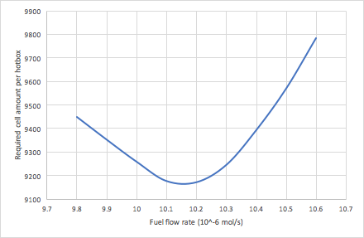
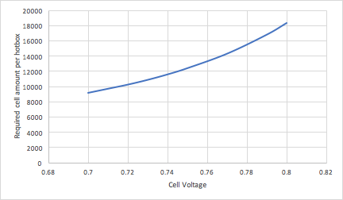
Process Optimization Analysis
Higher fuel flow rate per cell
Higher average reaction rate
Lower fuel utilization
A parabolic curve for power production per cell
Higher cell voltage
Lower total fuel flow rate
Less the required cell amounts

Slide 18
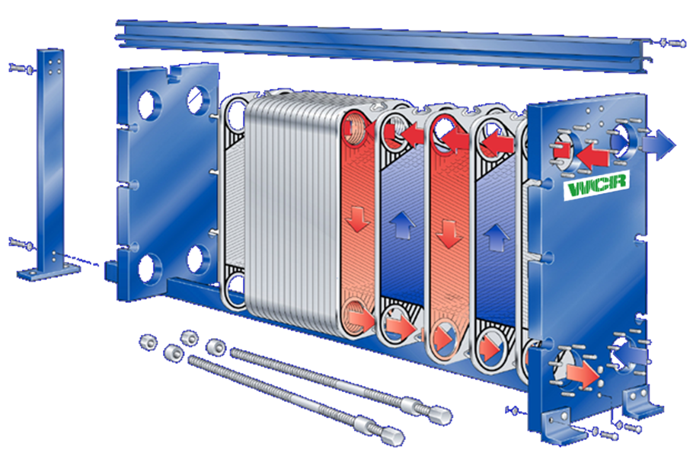
Future Recommendations
Increase insulation to avoid heat losses
Analyze and compare cross-flow and co-flow set-ups
Compare cell materials and characteristics to further improve utilization

Slide 19
Major Conclusions
Motivations include reliability, economics, and emission reduction
Basis of 150 MW from facility area and rack requirements
Each SOFC has 9200 cells, and produces 50 kW of power
Major expense of old system is electricity
New system has much cheaper utility (Natural Gas)
Each hotbox has 3 heat exchangers, an SOFC, and a tail burner section
10% profit over on grid connection if SOFC costs less than $179000

Slide 20
References
[1]United States. Department of Energy, Why SOFC Technology? [Online]. https://www.energy.gov/fe/why-sofc-technology. [Accessed: 4-25-2018]. [2] E. Garrison, “Solid Oxide Fuel Cells” mypages.iit.edu. [Online]. https://mypages.iit.edu/~smart/garrear/fuelcells.htm. [Accessed: 4-25-2018]. [3] https://www.eia.gov/dnav/ng/hist/n3035ut3m.htm
[4]42U Rack Dimensions & Specifications. 42U.org. [Online] http://www.42u.com/42U-cabinets.htm [Accessed 5-15-18]
[5]Does an Evaporative Cooler work in My Area? LumaComfort.com. [Online]. http://www.lumacomfort.com/blog/does-evaporative-cooler-work/
[6]J Niemann, K Brown, V Avelar. “Hot-Aisle vs. Cold Aisle Containment for Data Centers” . Mission Critical Magazine. [Online]. https://www.missioncriticalmagazine.com/ext/resources/MC/Home/Files/PDFs/WP-APC-Hot_vs_Cold_Aisle.pdf
[7]Bloom Energy. “Energy Server 5,” 2016. [Online]. https://www.bloomenergy.com/sites/default/files/es5-300kw-datasheet.pdf [Accessed: 4-25-2018].
[8]J Judge, J Pouchet, A Ekbote. “Reducing Data Center Consumption”. [Online]. http://ashraephilly.org/images/downloads/CTTC_Articles/1503_cttc.pdf
[9] http://www.dudadiesel.com/heat_exchangers.php [10] D. Myers, J. D. Carter, R. Kumar, https://www.hydrogen.energy.gov/pdfs/progress04/ivj3_myers.pdf [11]http://thermalscienceapplication.asmedigitalcollection.asme.org/article.aspx?articleid=2295642 [12]B.C.H., Atkinson, A., Kilner, J.A., Brandon, N.P., Rudkin, R.A. , Fuel Cells Steele, US patent US6794075(B2). Sept 21 2004.

Slide 21
Questions?

